Slide 1

CERTIFICATE III IN AUTOMOTIVE REPAIR & MAINTENANCE
SUBJECT: VEHICLE MAINTENACE AND REPAIR
By Ibrahim siraj
Maldives polytechnic

Slide 2
VEHICLE MAINTENACE AND REPAIR
Chapter 3 Wash clean vehicle body and interior
Introduction
The "Mazda Demio SKYACTIV"
refers to models of the Mazda Demio (known internationally as the Mazda2) that feature Mazda's SKYACTIV technology,
which focuses on improving fuel efficiency through advanced engine design and other features.
Specifically, it often refers to the 2011-2012 facelifted models equipped with the SKYACTIV-G 1.3 engine, which was highly efficient for its time.
These vehicles combined the engine with an i-stop idling system and a CVT for outstanding fuel economy.
By Ibrahim siraj
Maldives polytechnic

Slide 3
VEHICLE MAINTENACE AND REPAIR
Chapter 3 Wash clean vehicle body and interior
Maintenance Schedule
By Ibrahim siraj
Maldives polytechnic

Slide 4
VEHICLE MAINTENACE AND REPAIR
Chapter 3 Wash clean vehicle body and interior
Interior cleaning – Start inside Out
By Ibrahim siraj
Maldives polytechnic

Slide 5
VEHICLE MAINTENACE AND REPAIR
Chapter 3 Wash clean vehicle body and interior
Interior cleaning – Start inside Out
Work in shaded area to prevent soap from drying too quickly
Step Action Key Tools & Tips
1. Wheels First Clean wheels/tires with a dedicated cleaner and separate brush to avoid spreading brake dust to the paint.
2. Pre-Rinse Rinse the entire car (top to bottom) to remove loose dirt and debris.
3. Two-Bucket Method Use one bucket with soapy water, the second with clean water to rinse your wash mitt (reduces scratches).
4. Wash Body Wash top-down in straight lines using a microfiber mitt to prevent swirl marks.
5. Final Rinse Rinse thoroughly to remove all soap residue, checking crevices like the gas cap area.
6. Dry Dry immediately with a large, clean microfiber towel or chamois to prevent water spots.
By Ibrahim siraj
Maldives polytechnic

Slide 6
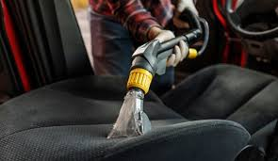
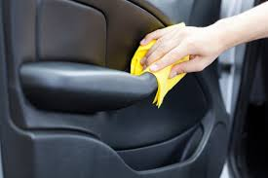
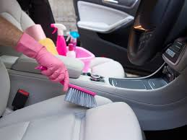
VEHICLE MAINTENACE AND REPAIR
Chapter 3 Wash clean vehicle body and interior
Interior cleaning – Start inside Out
Work in shaded area to prevent soap from drying too quickly
Key Takeaway
Systematic Approach: Interior first, then exterior, always working top to bottom.
Right Tools: Use dedicated automotive cleaners and microfiber cloths/mitts to protect surfaces.
Shade: Work out of direct sunlight for best results.
By Ibrahim siraj
Maldives polytechnic

Slide 7
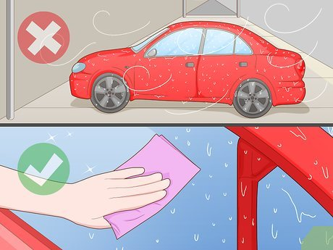
VEHICLE MAINTENACE AND REPAIR
Chapter 3 Wash clean vehicle body and interior
Interior cleaning – Start inside Out
Work in shaded area to prevent soap from drying too quickly
List of Supplies:
Two Buckets (one for soap, one for rinsing the mitt)
Grit Guards (placed in the bottom of buckets to trap dirt)
pH-Neutral Car Wash Soap (never dish soap!)
Soft Wash Mitt (microfiber or lambswool is ideal)
Hose with a spray nozzle or a pressure washer
Microfiber Drying Towels (for patting dry, not wiping)
Dedicated wheel brush and cleaner
By Ibrahim siraj
Maldives polytechnic

Slide 8
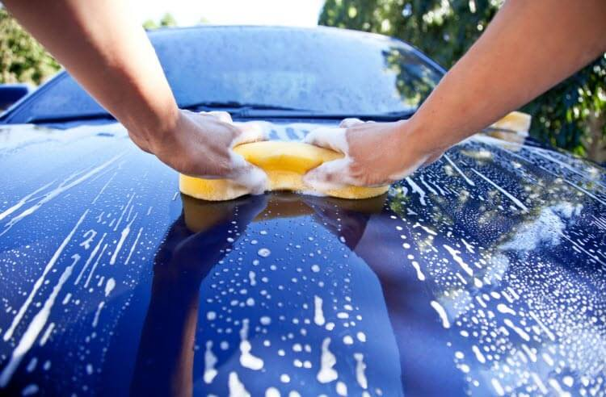
VEHICLE MAINTENACE AND REPAIR
Chapter 3 Wash clean vehicle body and interior
Interior cleaning – Start inside Out
Work in shaded area to prevent soap from drying too quickly
Location is Key: Always wash in the shade (early morning or late afternoon is ideal) to prevent soap from drying on the paint.
Cool Down: Ensure the car body is cool to the touch.
Wheels First: Clean the dirtiest part of the car first to prevent splashing grime onto clean paint later. Use a separate bucket and brush for the wheels.
Pre-Rinse (Optional Snow Foam): Use a hose to remove loose dirt and debris, or apply snow foam for extra lubrication before the contact wash.
By Ibrahim siraj
Maldives polytechnic

Slide 9
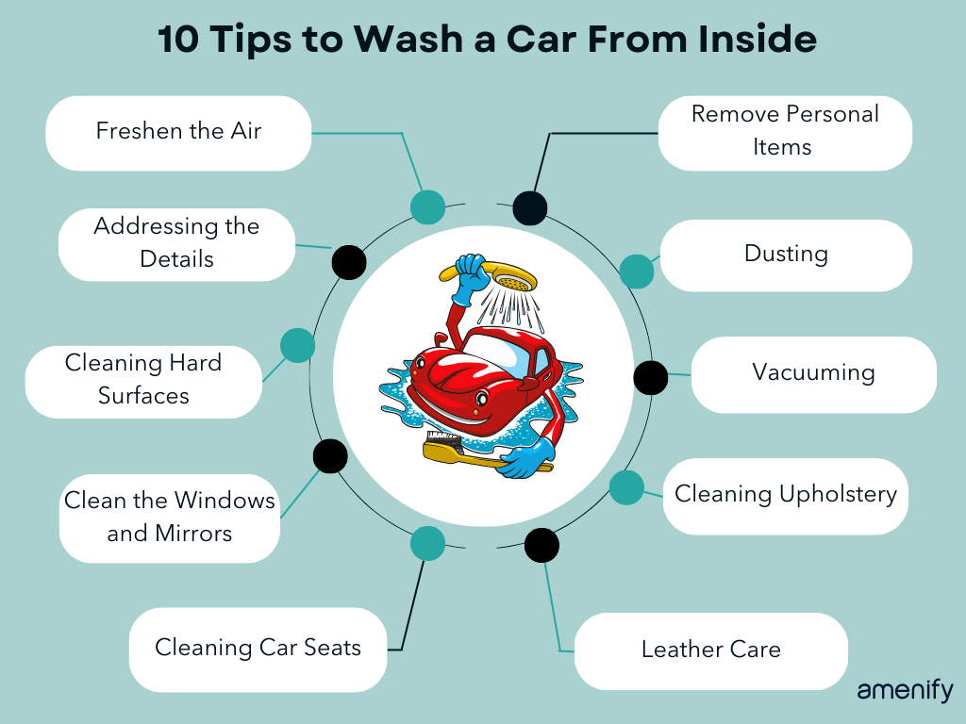
VEHICLE MAINTENACE AND REPAIR
Chapter 3 Wash clean vehicle body and interior
Interior cleaning – Start inside Out
Instruction
Start at the top of the car and work your way down.
Wash in straight lines (avoid circular motions which create swirls).
After each section (e.g., one-half of the roof), rinse the mitt in the clean water bucket to release trapped dirt.
Reload the mitt with clean soap from the "Wash" bucket.
By Ibrahim siraj
Maldives polytechnic

Slide 10
VEHICLE MAINTENACE AND REPAIR
Chapter 3 Wash clean vehicle body and interior
Interior cleaning – Start inside Out
Rinsing
Rinsing:
Rinse the entire car thoroughly with clean water, from top to bottom, ensuring no soap residue is left behind.
Drying (Crucial Step)
DO NOT let the car air dry (prevents water spots).
Use clean, large microfiber towels.
Pat dry the surface rather than wiping or dragging the towel.
Start drying from the top down.
By Ibrahim siraj
Maldives polytechnic

Slide 11
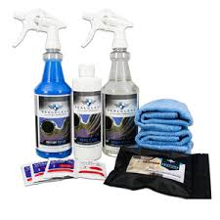
VEHICLE MAINTENACE AND REPAIR
Chapter 3 Wash clean vehicle body and interior
Interior cleaning – Start inside Out
Extra Shine (Detailing and Protection)
Windows: Use a dedicated auto glass cleaner and microfiber towel for streak-free windows.
Wax/Sealant: Apply a protective wax or sealant to protect the paint and enhance shine.
Tires/Trim: Apply tire shine and trim dressing for a complete look.
By Ibrahim siraj
Maldives polytechnic

Slide 12
AUTOMOTIVE ENGINE PRACTICE
Chapter 3 Basic Engine working principle
References
Internal Combustion Engines by V. Ganesan
Automobile Engineering by Kirpal Singh
Technical manuals: Honda, Cummins, Toyota
By Ibrahim siraj
Maldives polytechnic

Slide 13
THANK YOU

